Slide 1
Web Development
Developing the Web
reach out to me on IG @bill.lliu
- and linked in @ Bill Liu !!!

Slide 2
Introduction

Slide 3
WEBPAGE
HTML
JS
CSS

Slide 4
What are HTML, CSS, and JS ?
HTML (HyperText Markup Language): The “skeleton” of HTML-created websites, is a base structure and layout, used for website creation
JS (Javascript)- DIFFERENT FROM JAVA!: The “blood” of HTML-created websites, allows for basic programs and functions to be created; also most universal of the three, as can be used cross-platforms
CSS (Cascading Style Sheet): The “flesh” of HTML-created websites, stylizes a bland website with a spectrum of unique colours, fonts, and layouts

Slide 5

Think of a Cake:
HTML acts as the basic ingredients needed to make a bland, tasteless cake. You have a piece of bread.
Javascript acts as the additions that allow the cake to serve its purpose effectively, like the sugar and flavour. You now have a chocolate cake.
CSS adds the touch-ups that are frostings, decorations, and patterns. You now have a beautiful gateau chocolat with flower patterns and frosted designs.

Slide 6
Examples of HTML/JS/CSS Success
Cookie Clicker
RPG Maker
UNDERTALE
Oneshot
Hyper Light Drifter
Custom Websites
Custom Game Engines

Slide 7
Basics

Slide 8
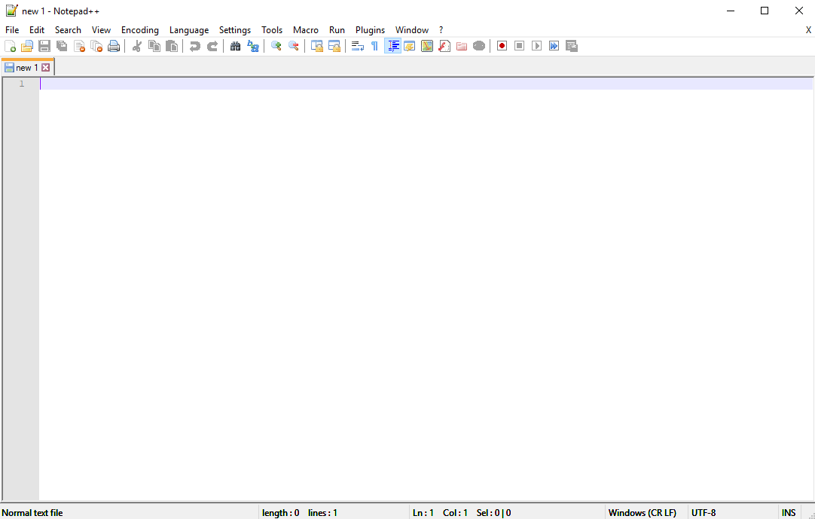
Notepad++
(but you can use anything) - the code is interpreted in a browser, meaning you can basically code on anything you want to

Slide 9
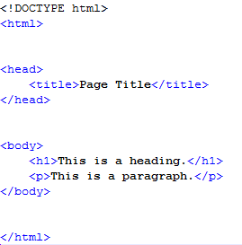
What does HTML look like?
This is some simple HTML code.
HTML has many important aspects, so let’s break down each piece found in this example.

Slide 10
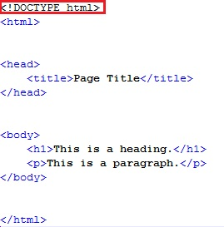
What does HTML look like?
Defines the document as HTML5

Slide 11
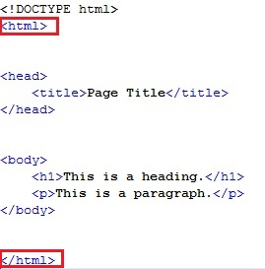
What does HTML look like?
This is an HTML element.
This element is the root element for an HTML page. Everything within the element will be used for the creation of the web page.
Each element usually comes with a pair of tags; a start tag and an end tag
<tagname>conent goes here</tagname>

Slide 12
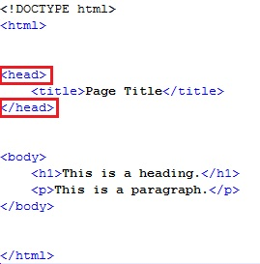
What does HTML look like?
This element contains metadata.
Metadata is data about the HTML document, but is not shown on the webpage.

Slide 13
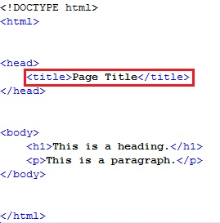
What does HTML look like?
This element is put within the <head> element.
It defines the title of the webpage, and the title can be seen in the tab name for the web page.

Slide 14
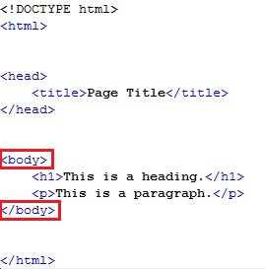
What does HTML look like?
This element contains the content that is visible on the web page.

Slide 15
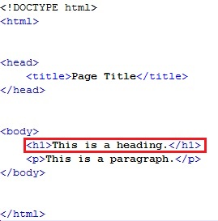
What does HTML look like?
This element defines a large heading.
There are 6 types of headings, each numbered “h1” - “h6”.
“h1” is the most important heading, and “h6” is the least important.

Slide 16
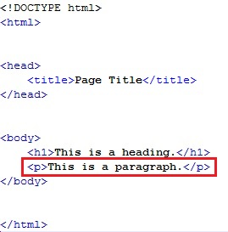
What does HTML look like?
Make sure you don’t have spelling errors!
This element defines a paragraph.
Paragraphs contain content written in regular font.

Slide 17
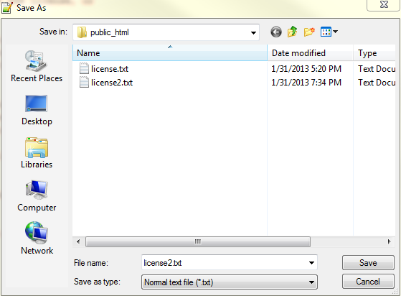
Executing a Website
To run the code created in Notepad++, simply save the project as a .html webpage, and open the file. A custom website will be created with all of the features your created code defined. The website can then be run anytime by opening the file.

Slide 18
Basic Syntax
Syntax is the “grammar” of your code. Proper syntax ensures your code runs smoothly and with no crashes.
Semicolons ( ; ) should be placed after every code line
You will know if something is a function if it lights up in a colour
Tags are required to sort the different parts of your code

Slide 19
Web Design, HTML, and Javascript
Stylizing

Slide 20
Commenting
Comments are notes written into the source code to help you.
They are not displayed by the browser.
To comment in HTML, use the following syntax:
<!-- Text Goes Here -->
Or utilize // before your comment text

Slide 21
Bolding, Italicizing, Underlining
To bold text, use the <b> and </b> tags.
To italicize text, use the <i> and </i> tags.
To underline text use the <u> and </u> tags.

Slide 22
Strong and Emphasis
<strong> and </strong> looks like <b> and </b>, but it implies semantic importance.
<em> and </em> looks like <i> and </i>, but it implies semantic importance.
Whenever you have important text that should be bolded or italicized, use the appropriate tags, as these tags mean that the text is “important”.

Slide 23
Other Tags
<mark> and </mark> - Highlighted text
<del> and </del> - Deleted text (Strikethrough)
<sub> and </sub> - _{Subscripted} text
<sup> and </sup> - ^{Superscripted} text

Slide 24
Attributes
Each element has various attributes that can be added to them.
An attribute defines additional information about the element, allowing you to do things such as change the colour, font, size, and location of the text.
All attributes are declared in the start tag of an element.
<p name=“value”>

Slide 25
Stylizing Attributes
To change the style of something, we use the “style” attribute. The value of the attribute would contain specific properties that change the style of the content.
To change the text color, use the property: “color” <p style=“color:red”>
To change the font, use the property: “font-family” <p style=“font-family:arial”>
To change the background color, use the property: “background-color" <p style=“background-color:lightblue”>

Slide 26
Links
Links in HTML act as hyperlinks, taking you to the linked website when clicked.
The syntax to create a link is as follows:
<a href=“url”>Text Here</a>
The href attribute is required, as it is the destination (the link can’t work without it). The text between the start and end tags is what will be visible to the user.
Text Here

Slide 27
Images
Images can be added to an HTML file using the <img> tag. The syntax to add an image is as follows:
<img src=“url” alt=“text” width=“100” length=“100”> OR <img src=“url” alt=“text” style=“width:100;length:100”>
This will add the image at the given URL to the HTML file. The alt attribute allows you to show specific text to the user when the image can not be accessed at the URL The values for width and length of an image are always measured in pixels.

Slide 28
CSS
CSS (Cascading Style Sheets) defines how a document should be displayed on the screen.
CSS can be introduced in 3 different ways:
Inline
Internal Style Sheet
External Style Sheet

Slide 29
CSS - Inline
To change the style using the inline method, add the style attribute in the start tag of what you wish to change.
<p style=“color:blue;font-family:arial”>
Within the style attribute, we write the name of what we want to change, followed by the appropriate value
In this case, the name would be color and font-family, and the values are blue and arial.

Slide 30
CSS - Colors
Colors can be referenced in one of three ways
A name - “red”
A HEX value - “FF0000”
An RGB value - “rgb(255,0,0)
To change the color of text you can use the color attribute, or in the style attribute, include “color: insert color here”

Slide 31
Challenge Time!
Thank you for your time!
Create a website that will contain the following in it:
Comments before every starting tag
1 bolded and 1 strong word
1 italicized and 1 emphasized word
Text that has been changed with attributes
An image
At least 1 link
Change the background color of the body to light blue
Change the background color of the paragraphs to a matching color
Questions?

